Slide 1


Social Distancing Indicator and Alarming System
A Project Presentation by:
Shreyas Bhardwaj 20171CSE0652
Shradha N 20171CSE0645
Shreya G 20171CSE0649
Shubham Sharma 20171CSE0655

Slide 2
Guide Details
I hereby declare that the work, which is being presented in the project report entitled “Social Distancing Indicator And Alarming System” in partial fulfilment for the course “Internet of Things” is a record of our own investigations carried under the guidance of Mr. Prakash B Metre and Ms. Manasa C M, Professor, Department of Computer Science and Engineering, School of Engineering, Presidency University, Bangalore.

Slide 3
Introduction
The main objective of this mini project is to build an I0T based Social Distancing Indicator and Alarming System.
The function of this application is to indicate the distance between the sensor and the object and send a warning signal through a Buzzer.
It is developed with the intension of controlling the spread of COVID-19 by using IOT tools to practice social distancing in an organized and safe manner.

Slide 4
Literature Survey
Currently there is no official device such as this implemented anywhere by any organization even at this time which will make this device very important and crucial in this fight against COVID-19 and other such transmitted diseases.
No technology being used in real time by general public other than awareness.
It is difficult to maintain social distancing without such device and by using only our sub-consciousness.

Slide 5
Problem Statement
The problem arises as an infectious disease which spreads when people come in close contact with each other.
It has been suggested that maintaining a distance of approximately 6 feet from another individual result in a marked reduction in transmission of most flu virus strains, including COVID-19.
In practice, this means that avoiding close proximity to other people will aid in slowing the spread of infectious diseases.

Slide 6
Technology Identification
Software Requirements:
Arduino Tinkercad
Arduino IDE
Hardware Requirements:
Arduino Uno Board
Ultrasonic Distance Sensor
9V Battery
Switch
Buzzer
Jumper wires

Slide 7
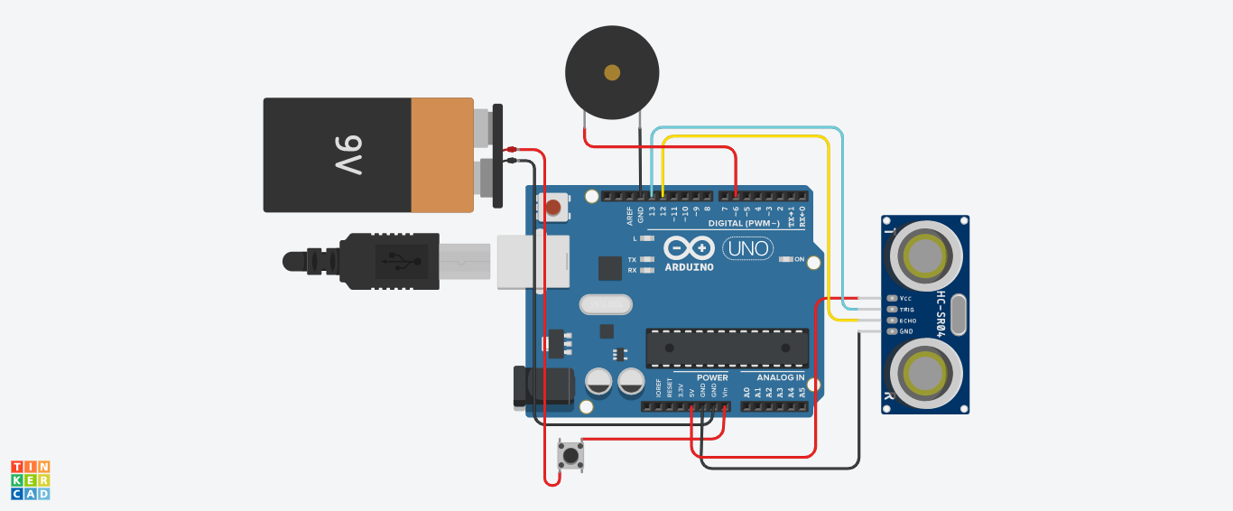
Design

Slide 8
Implementation
#define trigPin 13
#define echoPin 12
#define motor 7
#define buzzer 6
void setup()
{
pinMode(trigPin, OUTPUT);
pinMode(echoPin, INPUT);
pinMode(motor, OUTPUT);
pinMode(buzzer,OUTPUT);
}
void loop()
{
long duration, distance;
digitalWrite(trigPin, LOW);
delayMicroseconds(2);
digitalWrite(trigPin, HIGH);
delayMicroseconds(10);
digitalWrite(trigPin, LOW);
duration = pulseIn(echoPin, HIGH);
distance = (duration/2) / 29.1;
if (distance < 183) // This is where checking the distance you can change the value
{
digitalWrite(motor,HIGH); // When the the distance below 6 feet
digitalWrite(buzzer,HIGH);
} else
{
digitalWrite(motor,LOW); // when greater than 6 feet
digitalWrite(buzzer,LOW);
}
delay(500);
}

Slide 9
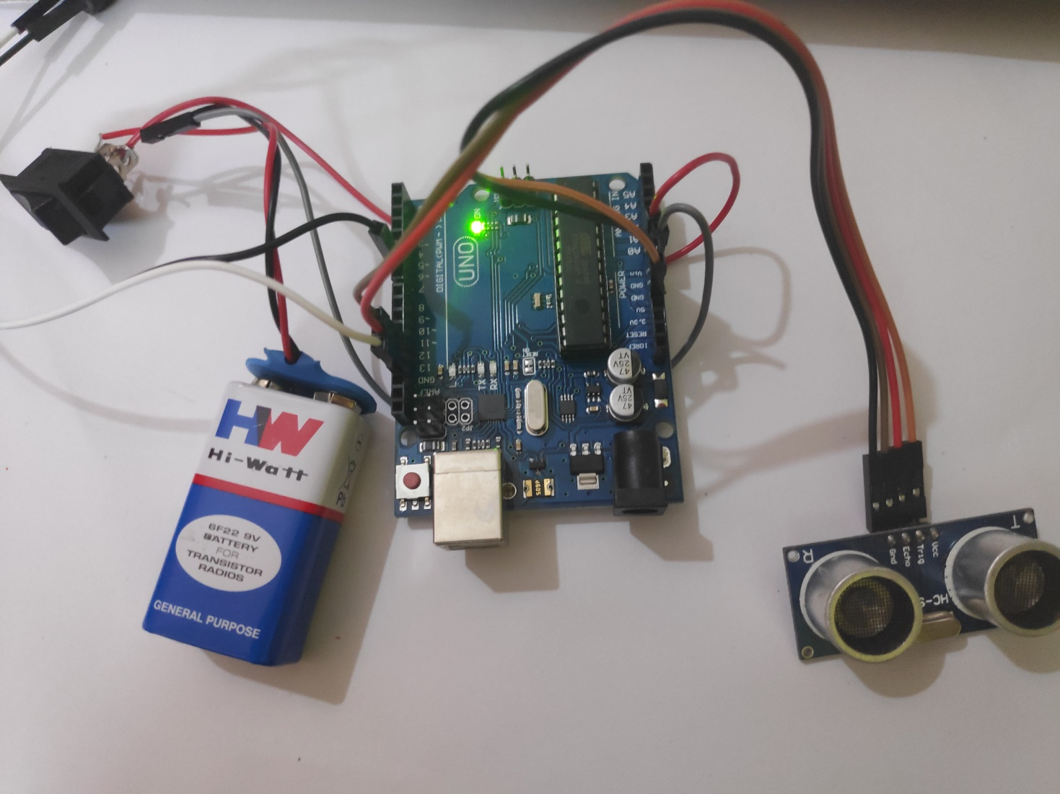
Implementation

Slide 10
Testing
We will test the project in two stages: software and hardware. The software part is to be tested via the Arduino IDE, whereas the hardware part has to be tested physically.
It is necessary to check whether the system is working properly or not. To check whether the readings are accurate, we will check the distance pointed out by the sensor by a meter tape.

Slide 11
Test Cases
Features to be tested:
The ultrasonic sensor should give proper output. To check whether the output is accurate or not, the output of the sensor will be checked against a meter tape
The Buzzer should turn on only when the distance is less than 6 feet or else it should automatically be off.
Arduino should be powered on only when the switch connected to the battery is on.
Expected output:
The expected output of this project should be a buzzer sound according to the distance reading which is taken from the ultrasonic sensor i.e., if less or more than 6 feet the buzzer turns on and off respectively.

Slide 12
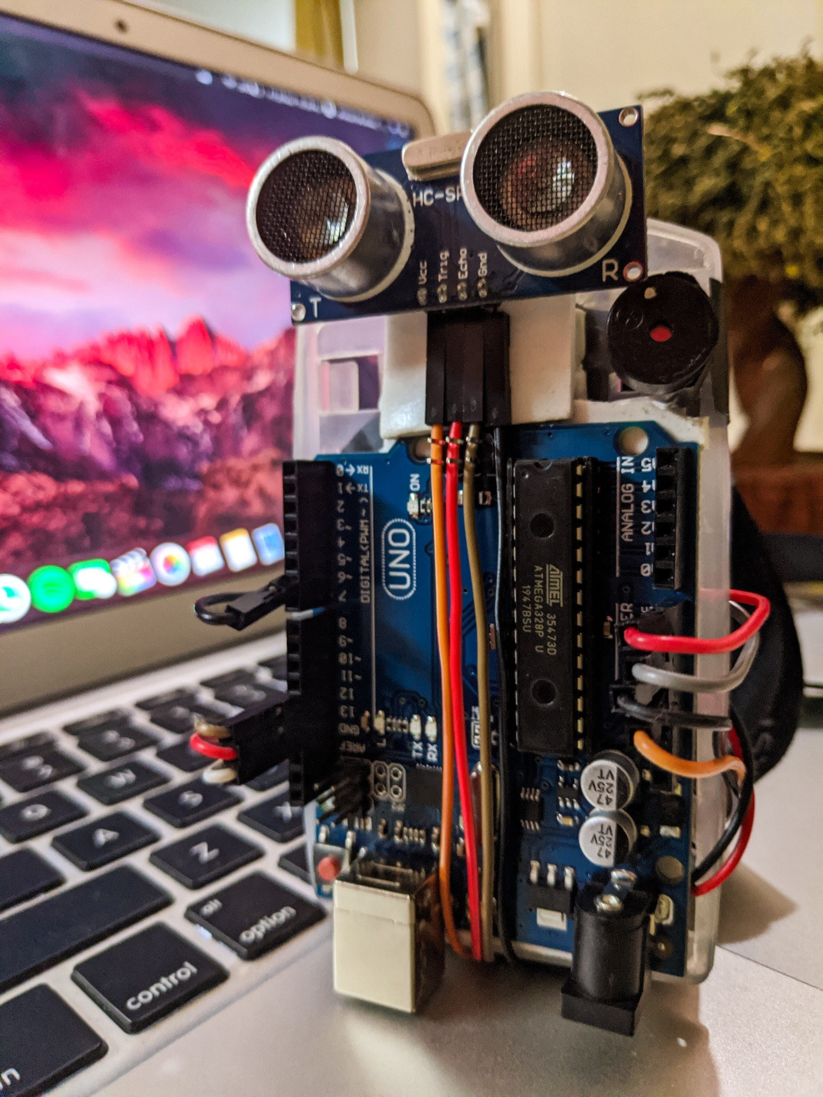
Results
As demonstrated, when a object/person comes close to the censor i.e. 6 feet, the buzzer gives an alarm indicating to the person that he/she is close to the object and is not maintaining social distance.

Slide 13
Enhancement
The device can be improved by:
Using Arduino Nano instead of Arduino Uno so that the device is even smaller and hence more portable.
Adding an RGB LED or a Vibration Sensor for loud environments where the buzzer sound might not be audible.
Product design could be made better which better cable management and overall design.
Charging Module can be added to charge the Battery for further long-time use.

Slide 14


